Slide 1
Pediatric Bone Age Prediction
Presentation By: Ruchi Rathod Student ID: 24801180

Slide 2
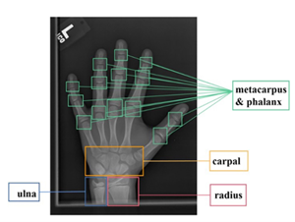
background
Traditional bone age assessment methods
Greulich-Pyle (G&P): Compare X-ray to reference atlas images.
Tanner-Whitehouse (TW): Score development of specific bones.
Limitations: Time-consuming and prone to variability between and within observers.
Need for automation
Machine learning & deep learning techniques are faster, consistent and Scalable.
(Li et al., 2023)

Slide 3
Aim & Objectives
Clear research question.
Aim: Automate pediatric bone age prediction from hand X-rays using a Deep learning system with a user-friendly interface.
Objectives:
Dataset: Utilize the RSNA Pediatric Bone Age dataset and implement robust preprocessing for high-quality input.
Model: Develop and optimize deep learning models (CNNs with attention mechanisms) for accurate bone age prediction.
Deployment: Create a user-friendly interface for real-time prediction, visualization, and report generation.

Slide 4
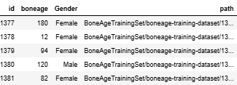
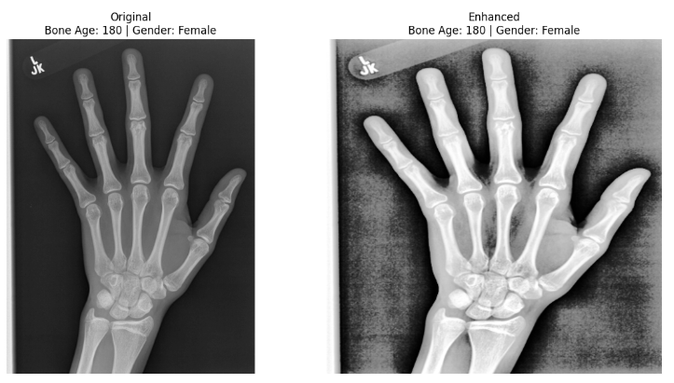
Data
Data – RSNA Pediatric Bone Age Challenge 2017
14,236 hand & wrist X-rays
1–228 months
54% Male, 46% Female
Preprocessing & Augmentation
Contrast enhancement: CLAHE, Histogram Equalization
Noise reduction: Bilateral Filtering
Standardization: Resizing & Normalization
Variability techniques: Horizontal flipping, small rotations (±10°), zoom & random cropping, rescaling

Slide 5
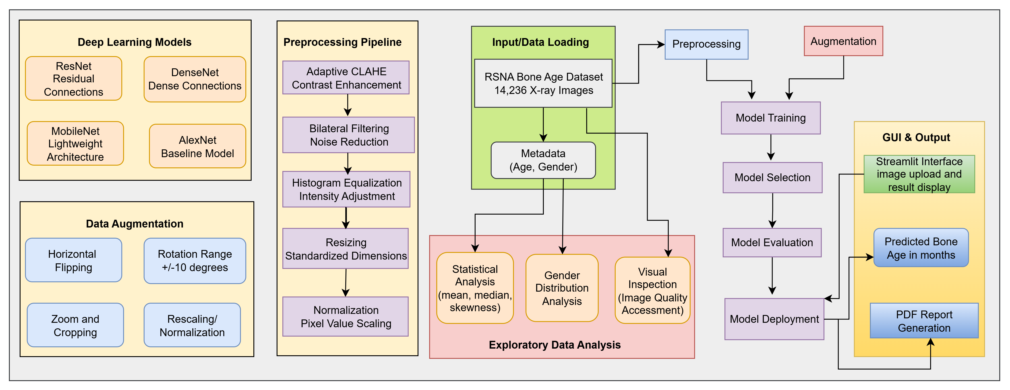
Method
Developed a deep learning workflow that included data preparation, augmentation, and model optimization, and deployed it through an interactive interface for automated bone age prediction.

Slide 6
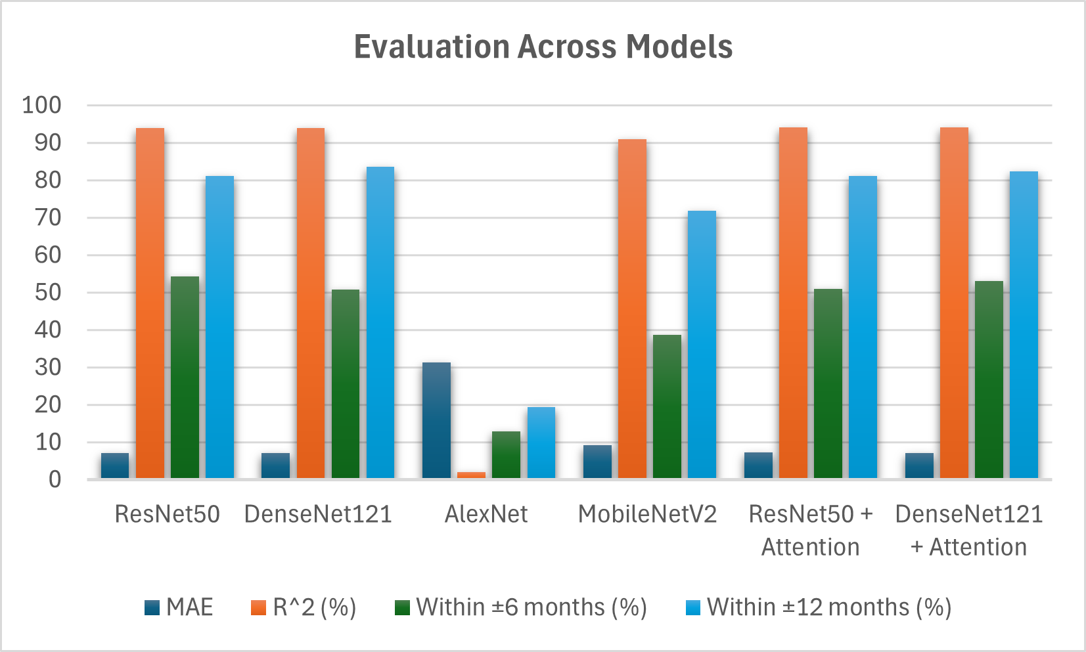
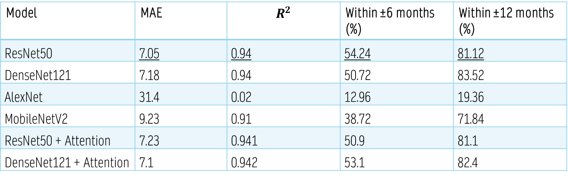
Results
Model | MAE | $$R^{2}$$ | Within ±6 months (%) | Within ±12 months (%)
ResNet50 | 7.05 | 0.94 | 54.24 | 81.12
DenseNet121 | 7.18 | 0.94 | 50.72 | 83.52
AlexNet | 31.4 | 0.02 | 12.96 | 19.36
MobileNetV2 | 9.23 | 0.91 | 38.72 | 71.84
ResNet50 + Attention | 7.23 | 0.941 | 50.9 | 81.1
DenseNet121 + Attention | 7.1 | 0.942 | 53.1 | 82.4

Slide 7
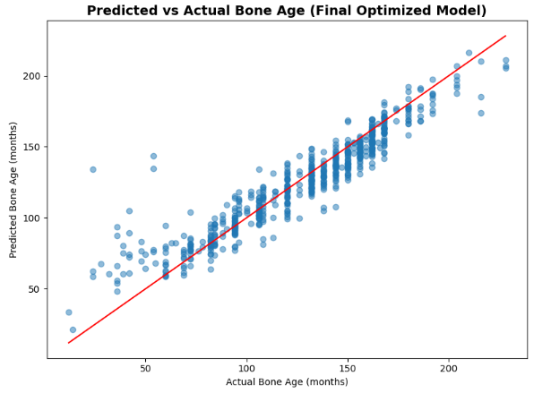
Results
ResNet50 identified as the best-performing model
Optimized using 5-fold cross-validation and hyperparameter tuning
Best parameters: learning rate = 0.0005, batch size = 32, epochs = 20
Evaluated on unseen test data:
MAE: 9.68 months
R² Score: 87.3%
Accuracy within ±6 months: 42.2%
Accuracy within ±12 months: 71.2%

Slide 8
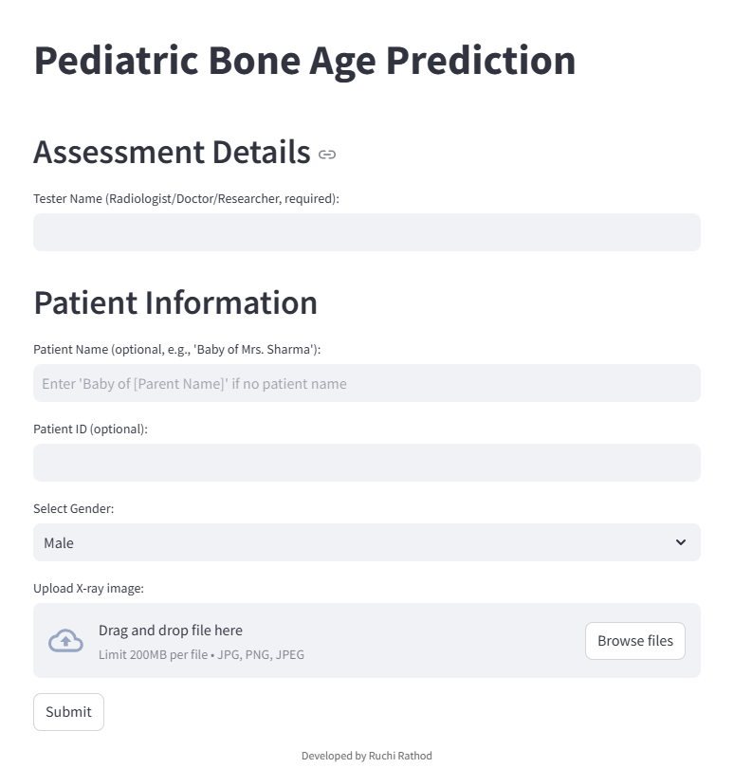
User Interface
Developed using Stream-lit for rapid, low-code deployment
Allows X-ray upload and metadata entry
Displays original & preprocessed images
Shows predicted bone age in few mins
Generates downloadable PDF reports
Designed for ease of use and potential clinical application
Upload X-ray + Metadata → Preprocessing → Prediction (ResNet50) → Display Results → PDF Report

Slide 9
Conclusion& Future Scope
Manual bone age assessment is slow and error-prone.
Deep learning method avoid the need of manual feature engineering.
ResNet50 (tuned) performed well on unseen data, with gender-aware attention improving focus on key regions giving accuracy of 87%.
Streamlit GUI enabled fast predictions, visualizations, and PDF reports.
Deep learning is helpful but still requires cross-checking with doctors.
Future Scope: Advanced hyperparameter tuning and larger datasets for better performance.
Explore ensemble and transformer models, plus quality checks and anomaly detection.
Collaborate with radiologists for real-world validation.

Slide 10
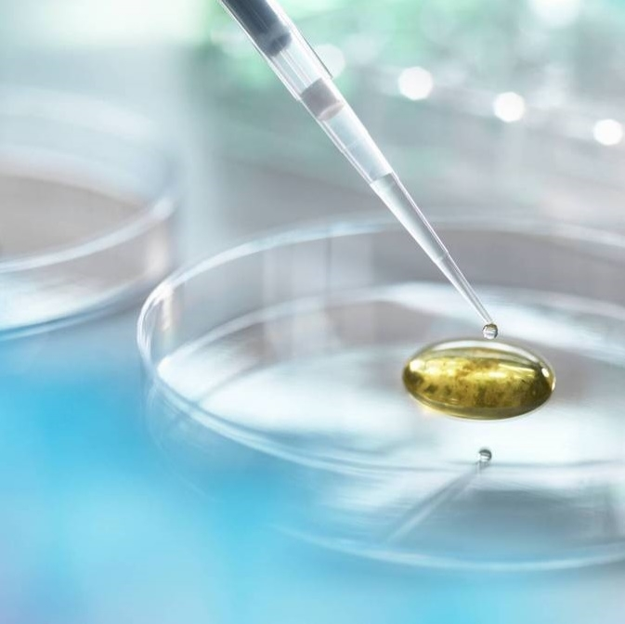
Thank you
Ruchi Rathod | 24801180

